Slide 1

Smart Learning Platform
Group members: Feng Yuqing, Wang Yi, Li Sinuo, Zhang Fangxiao
2025.2.26

Slide 2
CONTENTS
Introduction
Objective
Method
Expected Results
Milestone Plan

Slide 3
01
Introduction

Slide 4

Background and Motivation
This project aims to enhance students' learning experience by integrating AI technology and intelligent features. We will create an online learning platform that combines a virtual learning assistant, intelligent clock, and data analysis to meet demands for personalization, real-time feedback, and efficient management. The platform will provide real-time question answering, personalized feedback, immersive study tracking, and relaxation reminders, making the learning process more engaging and effective.

Slide 5
Brief Literature Review
Personalized Learning Benefits: Many studies show significant improvements in student outcomes.
AI-Driven Platforms: Platforms like Khan Academy and Coursera demonstrate adaptive learning that allows students to progress at their own pace with tailored feedback.
Research Insights:
Adaptive learning systems enhance learning results.
Real-time progress tracking improves engagement.
AI-driven resource recommendations provide valuable support. Interactive Elements: Quizzes, video lectures, and peer collaboration boost student engagement and motivation.

Slide 6
02
Objective

Slide 7
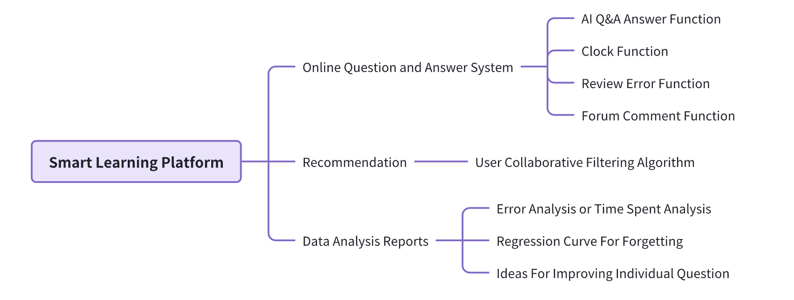
Objective
The goal of the intelligent learning platform is to create an AI-based, data-driven platform.
Notes:
图片解释：
A typical CNN is not just the 3 layer structure mentioned above, but a multi-layer structure, such as the structure of LeNet-5 as shown below:
Convolutional layer-Pooling layer-Convolutional layer-Pooling layer-Convolutional layer-Fully connected layer

Slide 8
03
Method

Slide 9
Method
Technology Stack and Development Process
Notes:
图片解释：
A typical CNN is not just the 3 layer structure mentioned above, but a multi-layer structure, such as the structure of LeNet-5 as shown below:
Convolutional layer-Pooling layer-Convolutional layer-Pooling layer-Convolutional layer-Fully connected layer

Slide 10
Method
Technology stack overview
Front-end: React / Vue Back-end: Spring Boot / mybatis Database: MySQL / mongodb AI tool chain: TensorFlow (recommendation algorithm) + Scikit-learn (learning effect prediction) Deployment: Docker
Notes:
图片解释：
A typical CNN is not just the 3 layer structure mentioned above, but a multi-layer structure, such as the structure of LeNet-5 as shown below:
Convolutional layer-Pooling layer-Convolutional layer-Pooling layer-Convolutional layer-Fully connected layer

Slide 11
04
Expected Results

Slide 12
Expected Results
A Smart Learning Platform
Offer personalized, flexible, and efficient learning experiences
Integrate AI technology and data analysis Provide tailored learning paths and resource recommendations based on individual needs
Monitor student progress in real-time and optimize interactive experiences
Enhance learning outcomes and foster interactions between students and teachers
Create a dynamic, collaborative, and innovative learning environment
Notes:
图片解释：
A typical CNN is not just the 3 layer structure mentioned above, but a multi-layer structure, such as the structure of LeNet-5 as shown below:
Convolutional layer-Pooling layer-Convolutional layer-Pooling layer-Convolutional layer-Fully connected layer

Slide 13
05
Milestone Plan

Slide 14
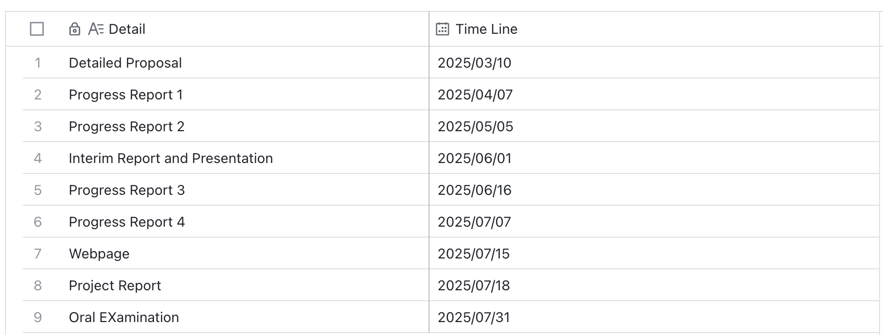
Milestone Plan

